Slide 1

COMPUTER ARCHITECTURE – CSA1221
Instruction Set Architecture Simulator
PRESENTED BY
USHA NANDHINI P
SHREE AISHWARAYA R
SOFIA
GUIDED BY,
DR.K.VIJAYA BHASKAR
Yavanika S [ 192521258 ] – Module 1: Shared Cache Design [ Team Member 2 Name – Reg. No. ] – Module 2: Coherence Protocol [ Team Member 3 Name – Reg. No. ] – Module 3: Performance Evaluation
GUIDED BY: [ Faculty Name ]

Slide 2


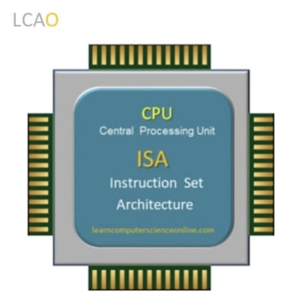
INTRODUCTION
An Instruction Set Architecture (ISA) is the set of instructions that a processor understands and executes.
Every program is converted into assembly instructions before being executed by the processor.
A processor executes each instruction through Fetch, Decode, Execute, Memory Access, and Write Back stages.
An ISA Simulator is a software model that mimics the behavior of a real processor without requiring physical hardware.
It helps visualize how instructions move through the processor and how different hardware components work together.
WITHOUT COHERENCE – AN INCONSISTENT VIEW
Core 0
Core 1
Cache: X = 5
Cache: X = 5
Main Memory: X = 5
Core 0 writes X = 9 in its own cache only → Core 1 still reads X = 5 → inconsistent result.
PROJECT OBJECTIVES
1
2
3
Design a RISC ISA simulator for instruction fetch and decode.
Implement instruction execution using Register File, ALU, and Memory.
Evaluate processor performance using Instruction Count, CPI, and Execution Time.
2

Slide 3
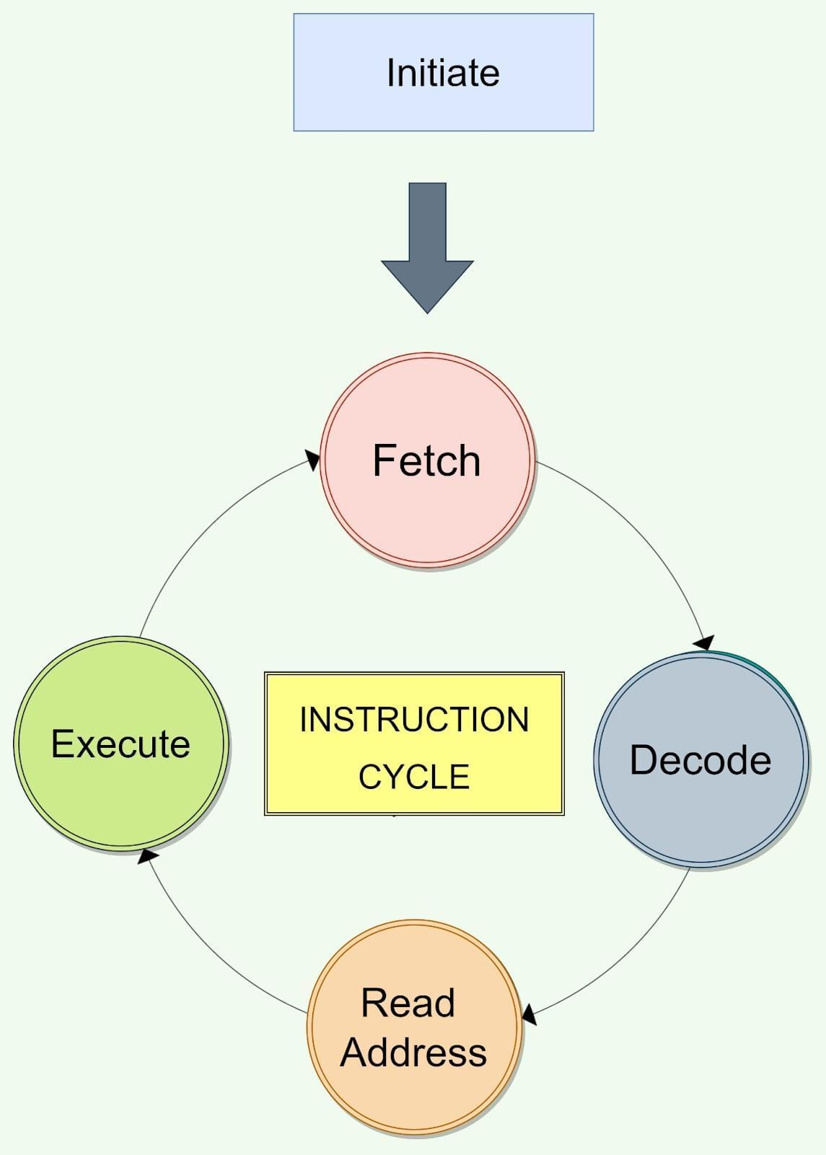
MODULE 1 INSTRUCTION FETCH AND DECODE
Fetch the instruction from the Instruction Memory using the Program Counter (PC).
Increment the Program Counter (PC) to point to the next instruction.
Decode the instruction by identifying the opcode (operation to be performed).
Extract the operands, including source registers, destination register, and immediate values.
Send the decoded instruction to the execution unit (ALU) for further processing.
CSA12 – COMPUTER ORGANIZATION AND ARCHITECTURE
5

Slide 4
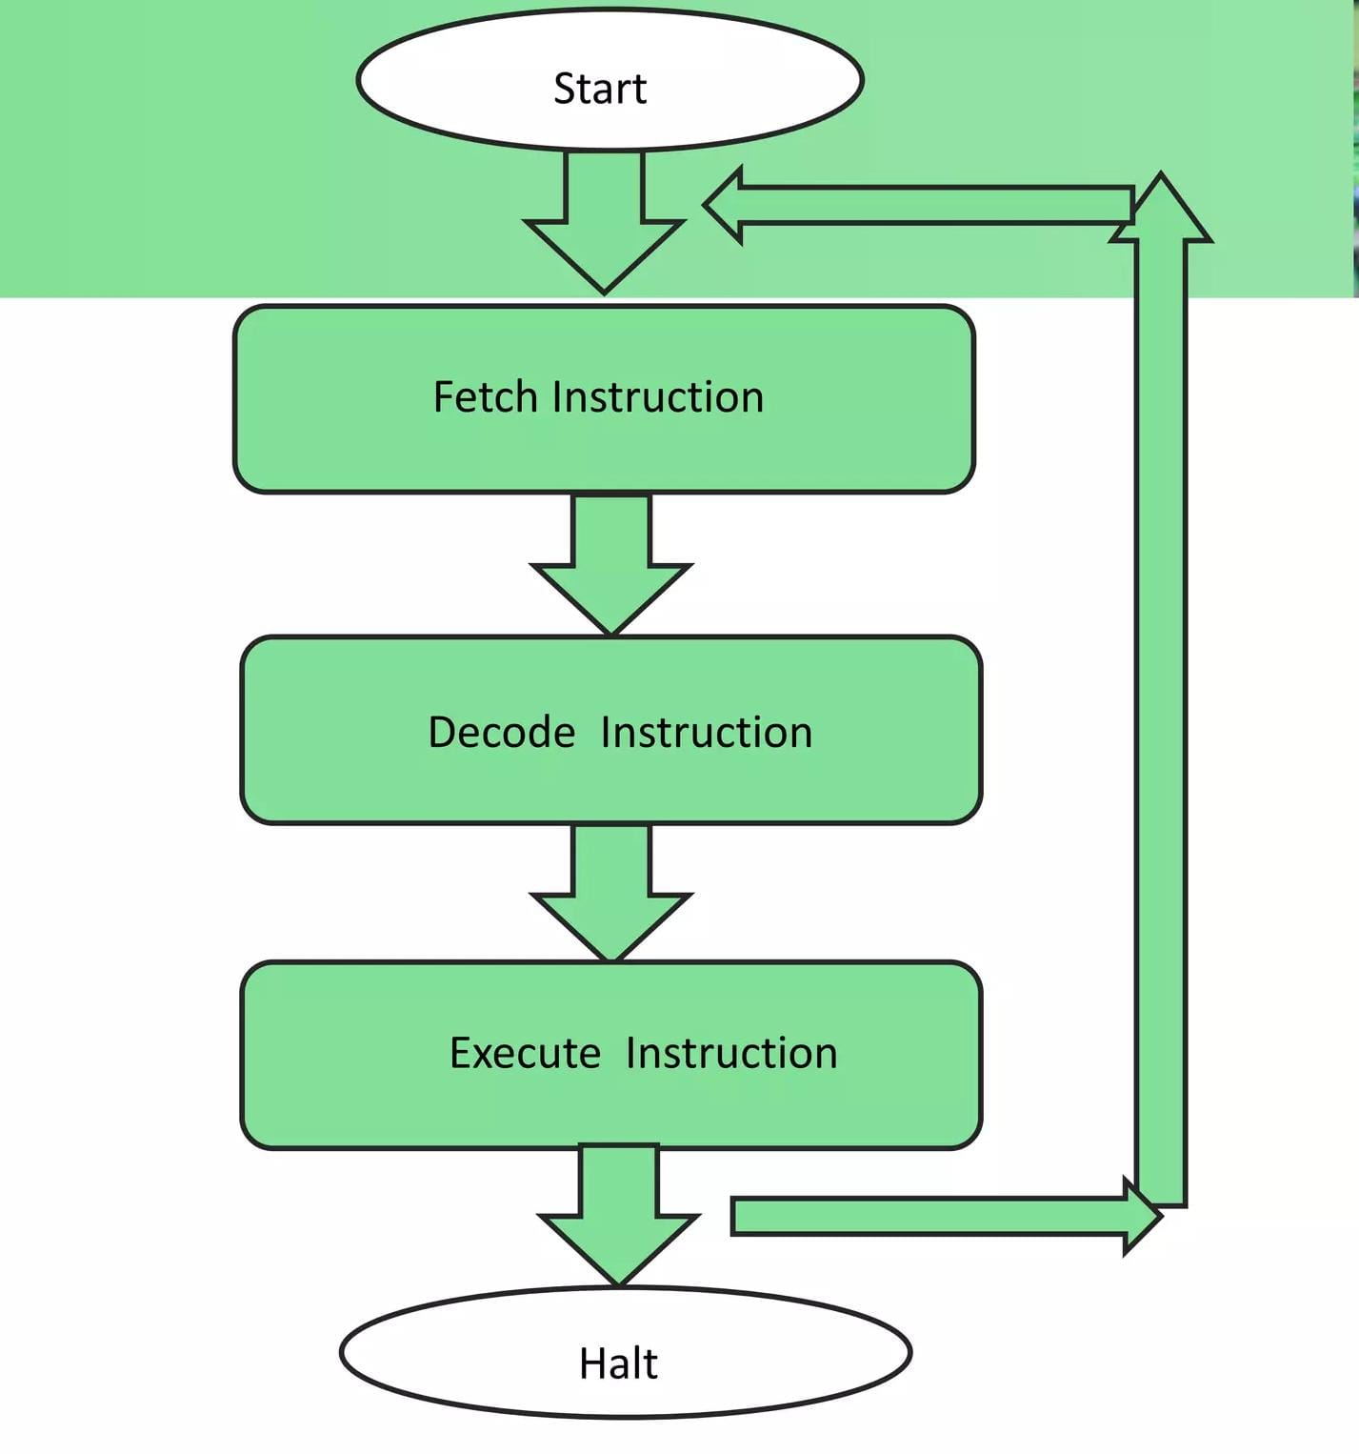
MODULE 2· INSTRUCTION EXECUTION
Read the required operands from the Register File based on the decoded instruction.
Execute the operation using the ALU, such as arithmetic, logical, or data transfer instructions.
Access Data Memory for LOAD and STORE instructions when required.
Write the execution result back to the destination register or memory location.
Complete the instruction execution and forward the processor to the next instruction.
CSA12 – COMPUTER ORGANIZATION AND ARCHITECTURE
8

Slide 5
MODULE 3
ISA PERFORMANCE EVALUATION
Count the total number of instructions executed during the simulation (Instruction Count).
Calculate the Cycles Per Instruction (CPI) to measure processor execution efficiency.
Compute the total Execution Time using the Instruction Count, CPI, and Clock Cycle Time.
Analyze the execution results to evaluate the correctness and performance of the simulated processor.
Generate a performance report displaying Instruction Count, CPI, Execution Time, and overall processor efficiency.
CSA12 – COMPUTER ORGANIZATION AND ARCHITECTURE
10

Slide 6
DISCUSSION
Advantages, Applications & Future Scope
ADVANTAGES
APPLICATIONS
FUTURE SCOPE
Visualizes processor execution by showing how instructions are fetched, decoded, and executed.
Improves understanding of RISC architecture and assembly language concepts.
Evaluates processor performance using Instruction Count, CPI, and Execution Time.
Computer Architecture laboratories for practical learning and demonstrations.
Assembly language education to understand instruction execution.
Processor design and simulation for academic projects and research.
Add pipeline simulation to improve execution efficiency.
Support advanced RISC-V instructions and additional instruction formats.
Develop a graphical user interface (GUI) for real-time visualization of instruction execution.
CSA12 – COMPUTER ORGANIZATION AND ARCHITECTURE
13

Slide 7
CONCLUSION
Bringing the Three Modules Together
The Instruction Set Architecture (ISA) Simulator successfully demonstrates the complete instruction execution process, including Fetch, Decode, Execute, Memory Access, and Write Back.
It accurately simulates the functions of the Register File, ALU, Decoder, and Memory while executing RISC assembly instructions.
The simulator evaluates processor performance using Instruction Count, CPI, and Execution Time, making it an effective tool for learning and analyzing computer architecture concepts.
THANK YOU

